Slide 1















Better Than Nothing
A case study of limitations developing a resource sharing hub for primary and secondary care
Nadia Kuftinoff
Senior Digital Delivery Lead
Buckinghamshire Oxfordshire and Berkshire West Integrated Care Board

Slide 2
The Problem
The contract for a website which hosts shared care protocols and guidance is ending
The current suppliers have quoted ~£40k
A shared resource between different teams with no clear ownership
Seen as a Digital Problem
No resource allocation at all

Slide 3
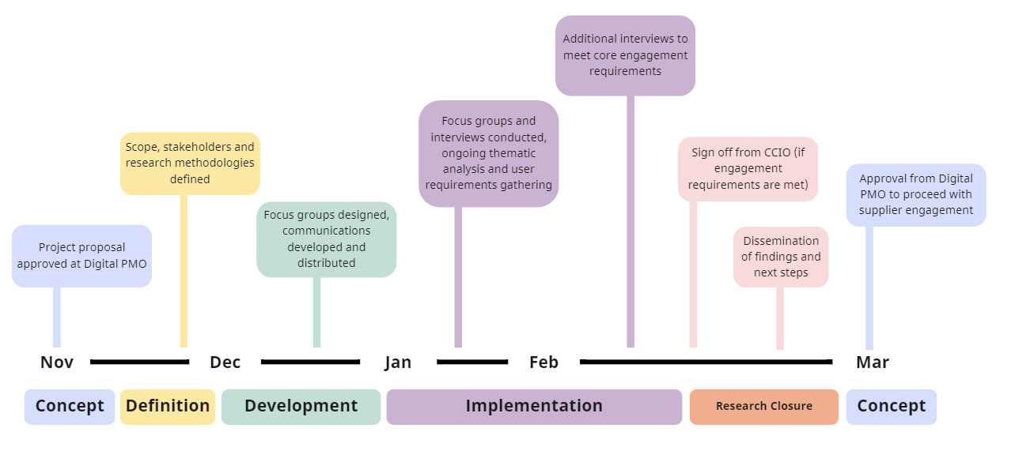

Slide 4
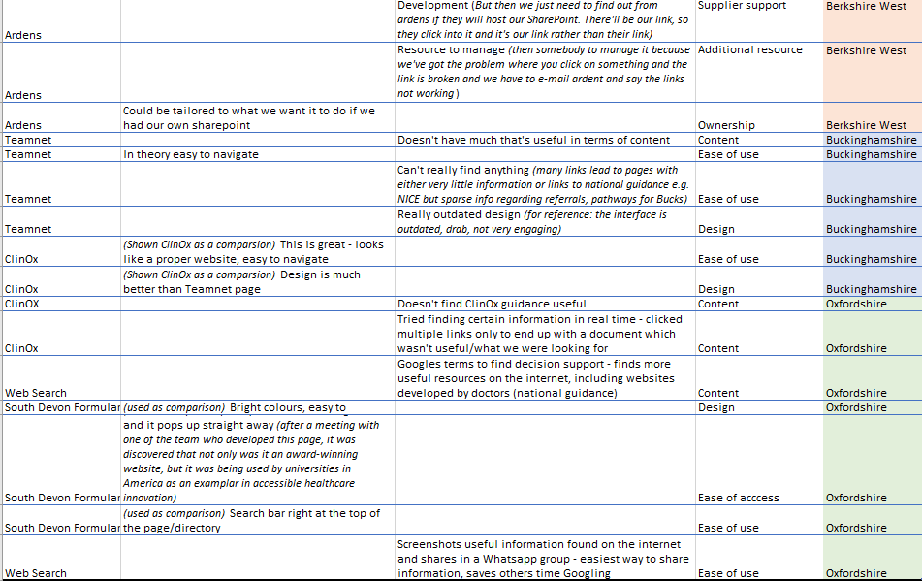
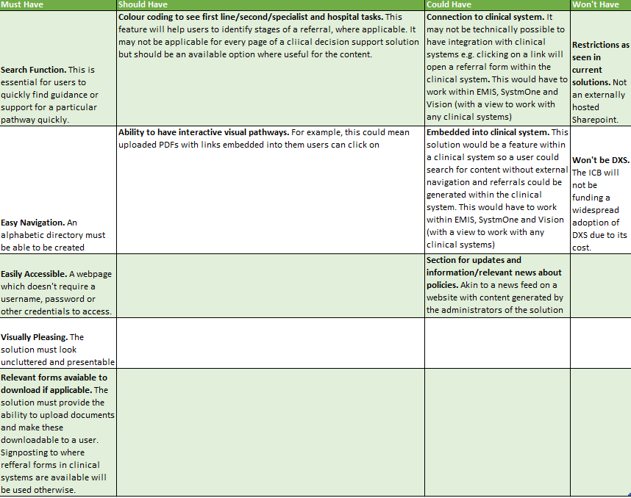
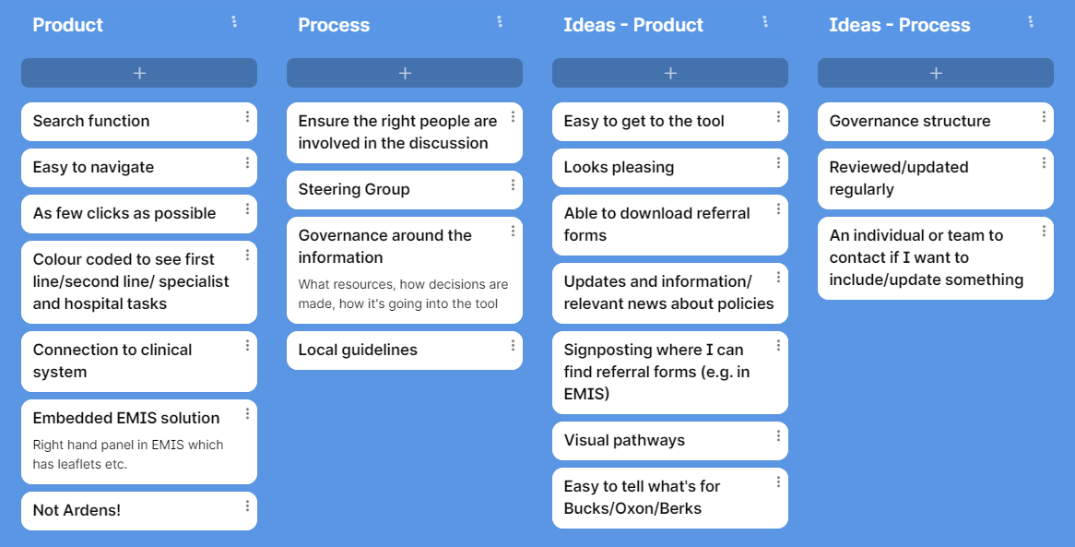
Thematic analysis to inform solution requirements
User Research
GPs across BOB including one who also works in secondary care
Content Managers in Planned Care and Medicines Optimisation
Primary Care, including the Digital Primary Care Board
Communications Directorate
BOB Digital Forum
Digital Clinical Leads (GPs)
The ICB CMO and Executive Team
Requirements gathering through interviews

Slide 5
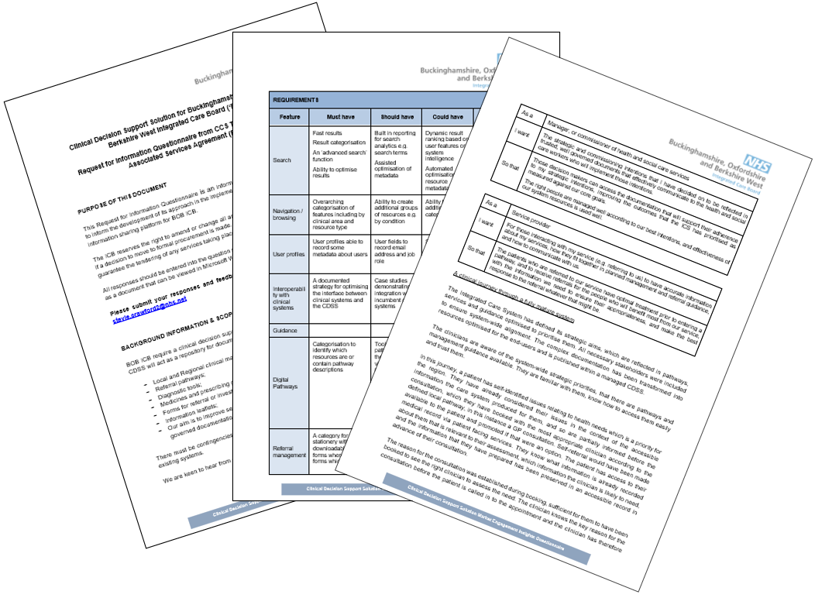
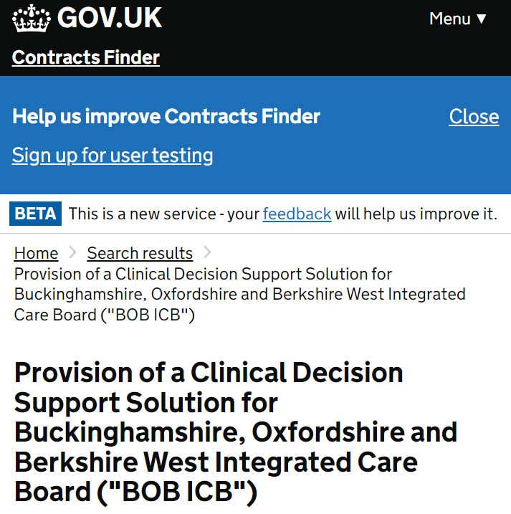
Procurement and ClinOx Funding
Responses to Requests for Information reviewed but solutions are offering out of scope functionality and are costly
New requirement emerges of wider accessibility
Early stakeholder feedback that there is no funding available for a new solution
Priority funding is required for the ClinOx contract, which also cannot be sourced

Slide 6
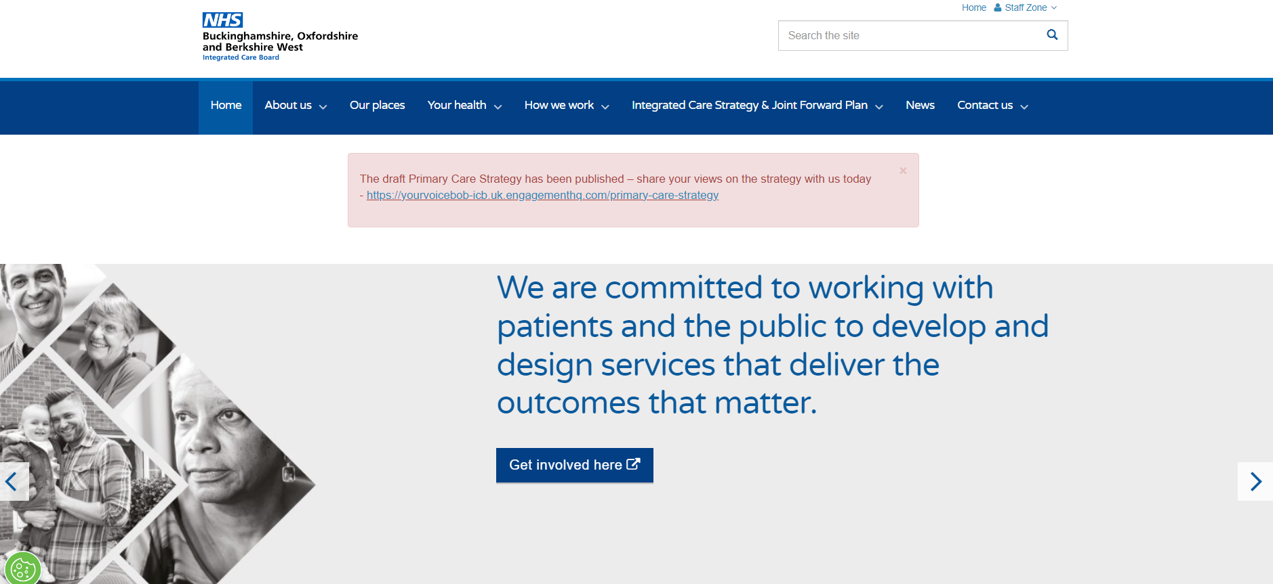
User Research, Procurement and ClinOx Replacement
Exec advise liaising with SCW CSU, the developers of the BOB ICB website
Communications Directorate are looking to re-procure their content management system
ClinOx could be recreated as a ‘microsite’
Timelines do not coincide with ClinOx contract expiry
Creating a SharePoint as an interim solution becomes necessary

Slide 7
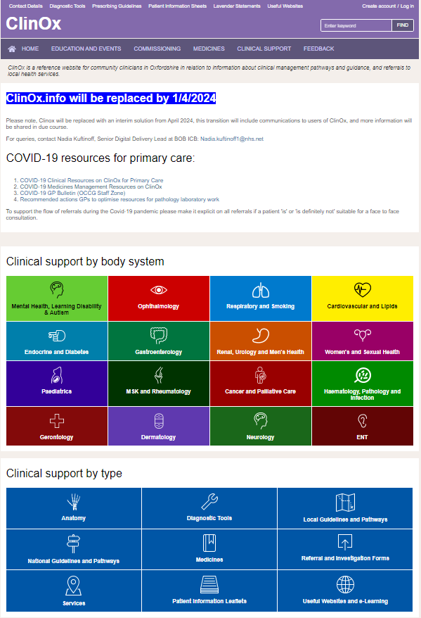
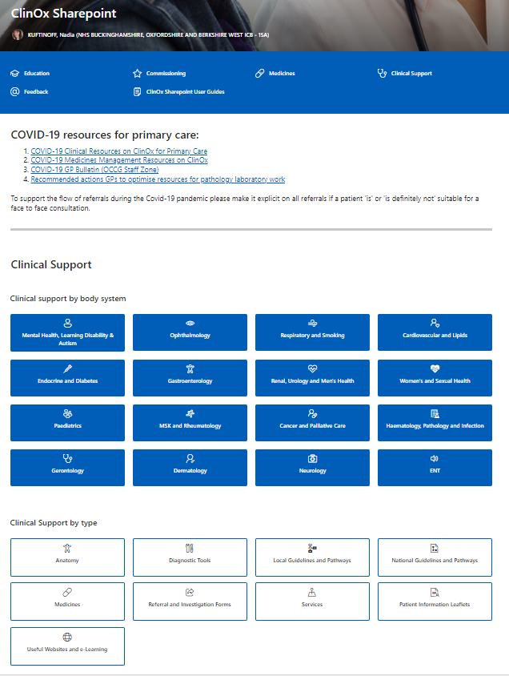

Slide 8
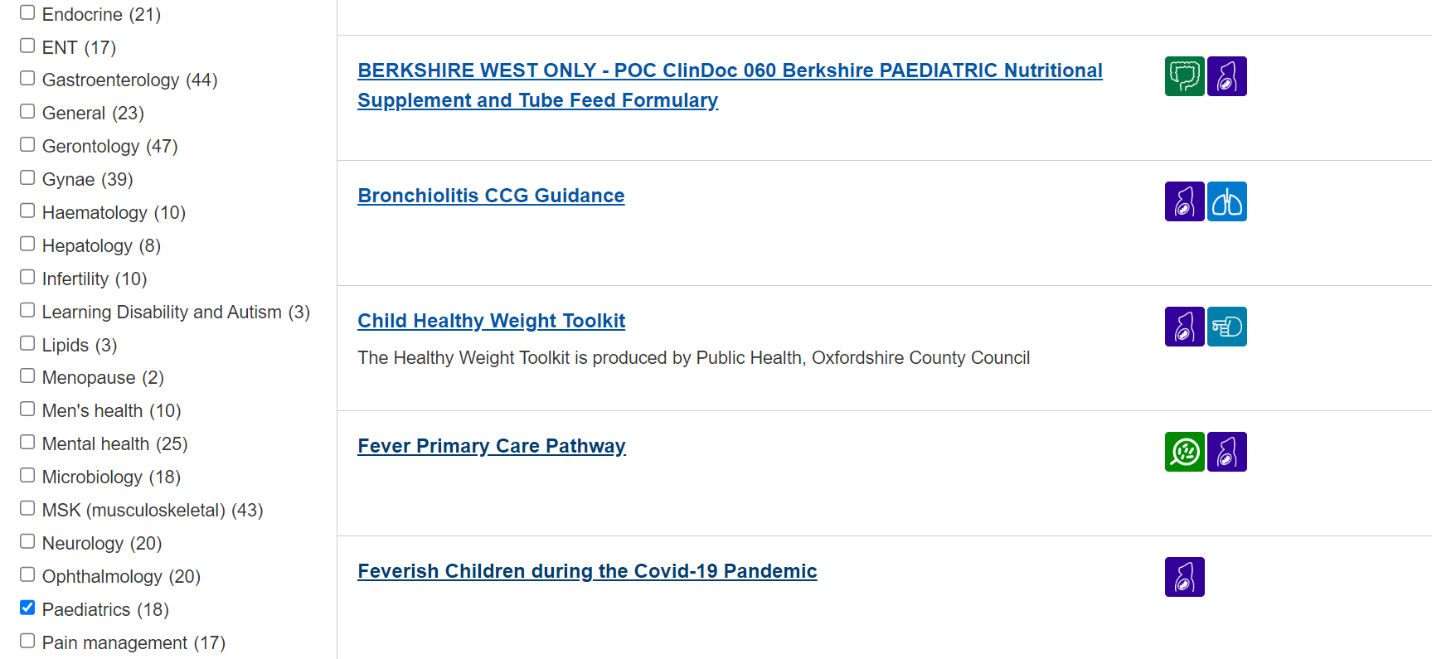
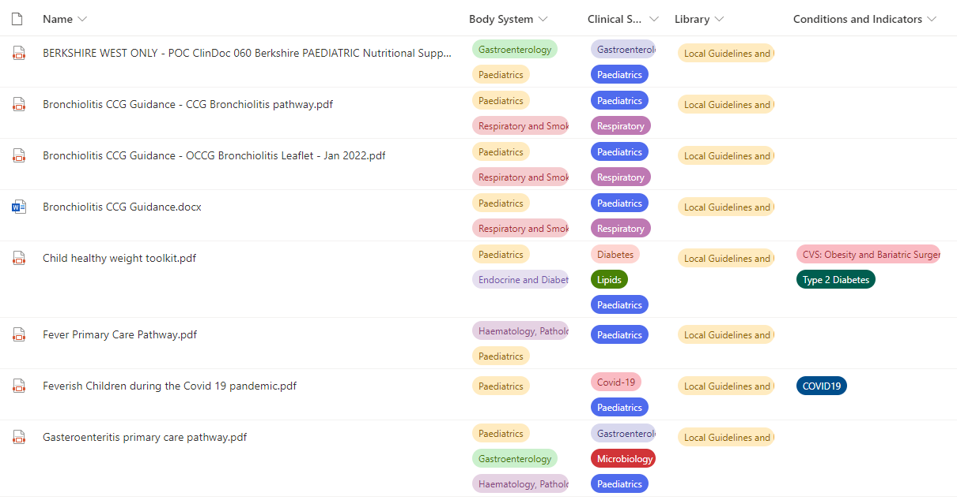

Slide 9
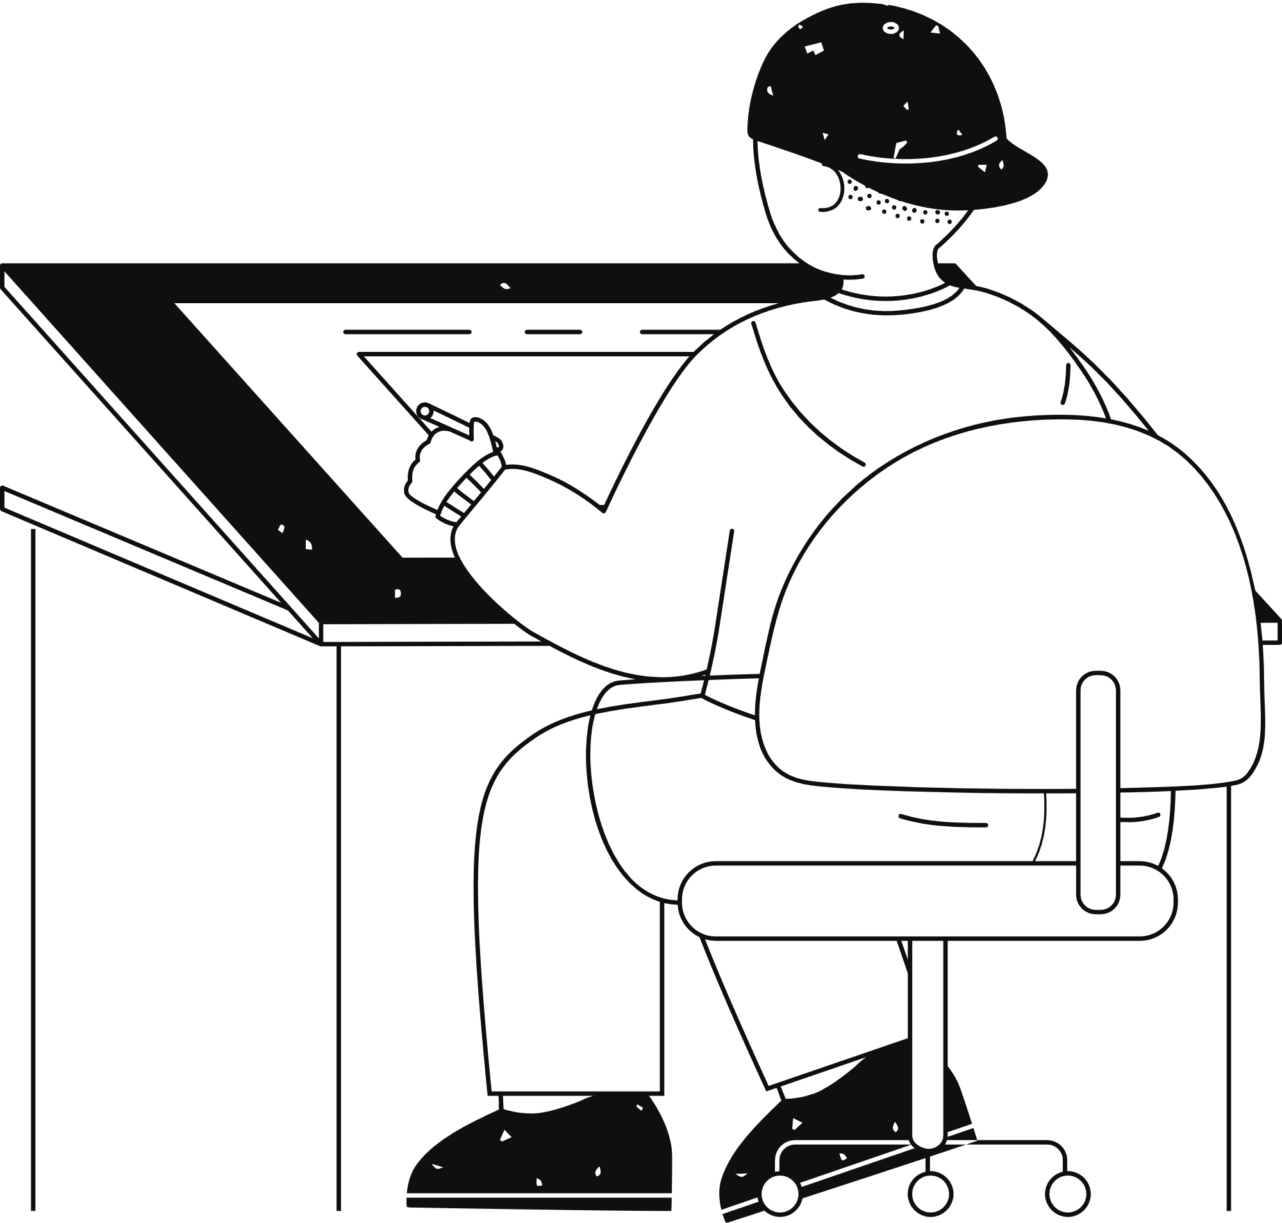






Guest Accounts into NHS Tenant (limitations!!!)

Slide 10
January 2024
Develop ClinOx SharePoint page
Migrate content from ClinOx to SharePoint
February 2024
Arrange whitelisting domains with SCW CSU
Request dedicated area on BOB ICB website for patient information leaflets
Develop training materials
Complete ClinOx data migration
Host training sessions with content managers
Develop comms and engagement resources
Comms and engagement across ICB and ICS to promote SharePoint
March 2024
Update ClinOx website that it is no longer in use with link to SharePoint
Iterative design user acceptance testing phase – tweak SharePoint as necessary
Comms and engagement across ICB and ICS to promote SharePoint
Set up domain URL redirect so links take a user to SharePoint automatically (for one year)
April 2024
Set up comms and engagement reminders on a quarterly basis regarding the redirect expiry
Ad hoc support where required
Begin planning manually changing formulary links (to be completed by February 2025)
ClinOx goes offline 31/03
Content managers stop updating ClinOx 29/02

Slide 11
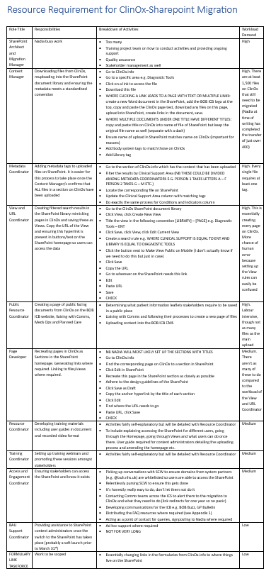
305 pages, 2053 files, 7813 tags
Downloading files from ClinOx, reuploading into the SharePoint document library and ensuring the metadata meets a standardised convention
Adding metadata tags to uploaded files on SharePoint. It is easier for this process to take place once the Content Manager/s confirms that ALL files in a section on ClinOx have been uploaded
Creating filtered search results in the SharePoint library mimicking pages in ClinOx and saving these as Views. Copy the URL of the View and ensuring this hyperlink is present in buttons/text on the SharePoint homepage so users can access the data
Creating a page of public facing documents from ClinOx on the BOB ICB website, liaising with Comms, Meds Ops and Planned Care
Recreating pages in ClinOx as Sections in the SharePoint homepage. Generating links where required. Linking to files/views where required.
Developing training materials including user guides in document and recorded video format
Setting up training webinars and promoting these sessions amongst stakeholders
Ensuring stakeholders can access the SharePoint and know it exists
Providing assistance to SharePoint content administrators once the switch to the SharePoint has taken place (probably a soft launch prior to March 31st)

Slide 12
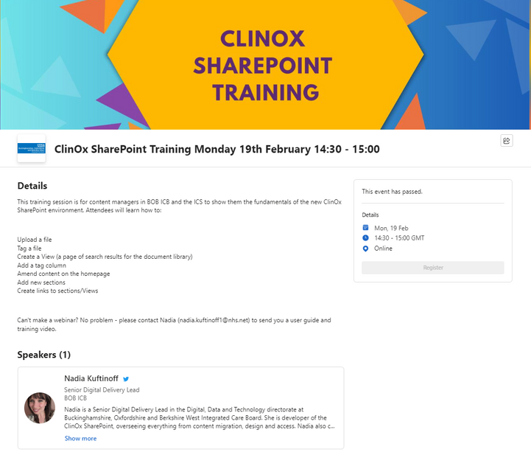


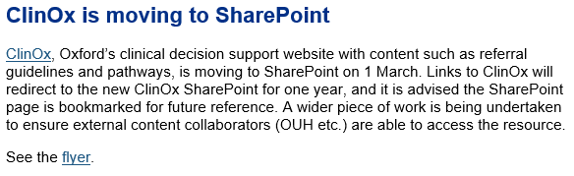
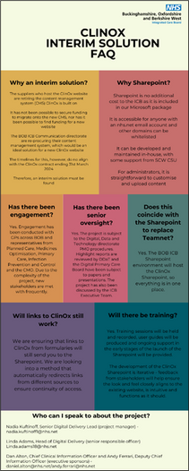
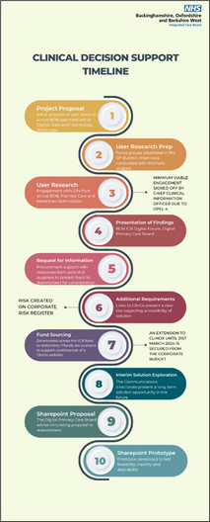
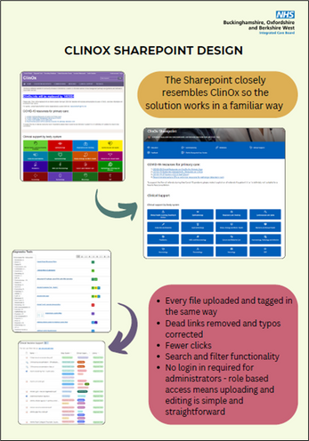
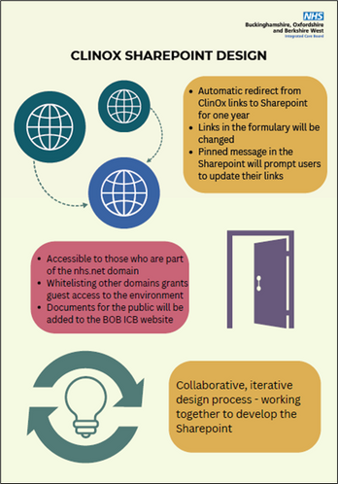
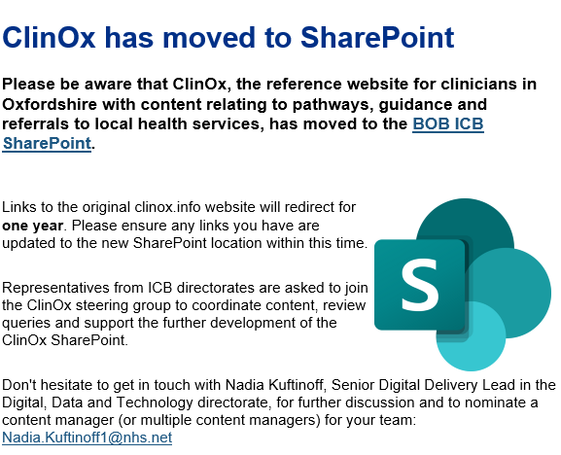

Slide 13
More Problems

Slide 14
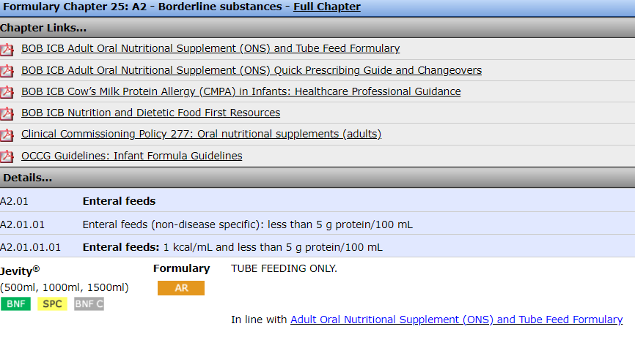

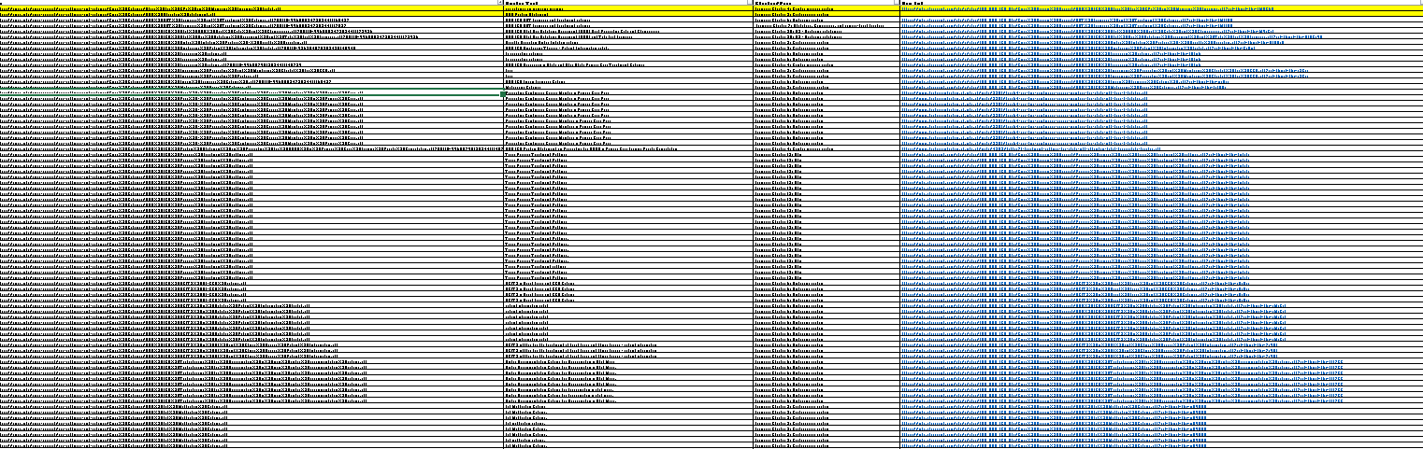
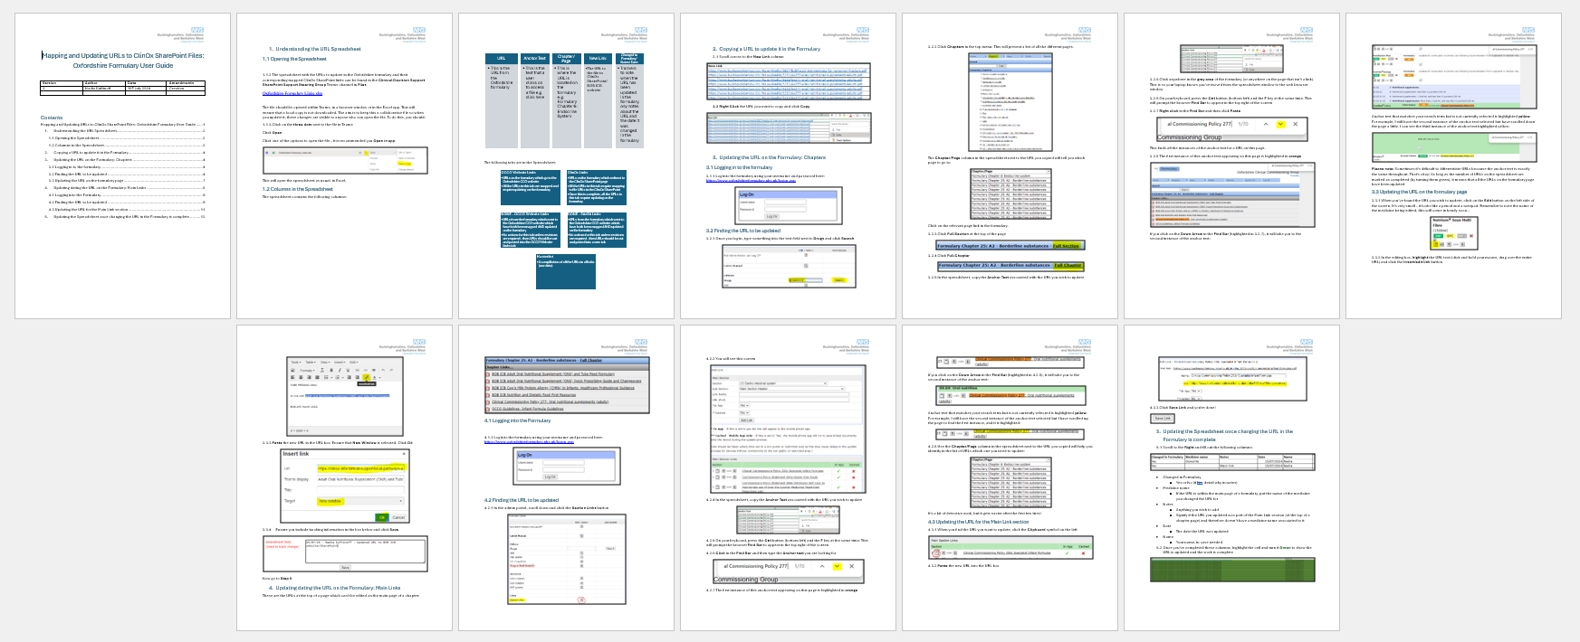
Nearly 1000 URLs required updating
URLs are located at the top of chapter pages and within the chapters
Mapped URL spreadsheet also used to cross-reference audit of changes
User guide & training

Slide 15
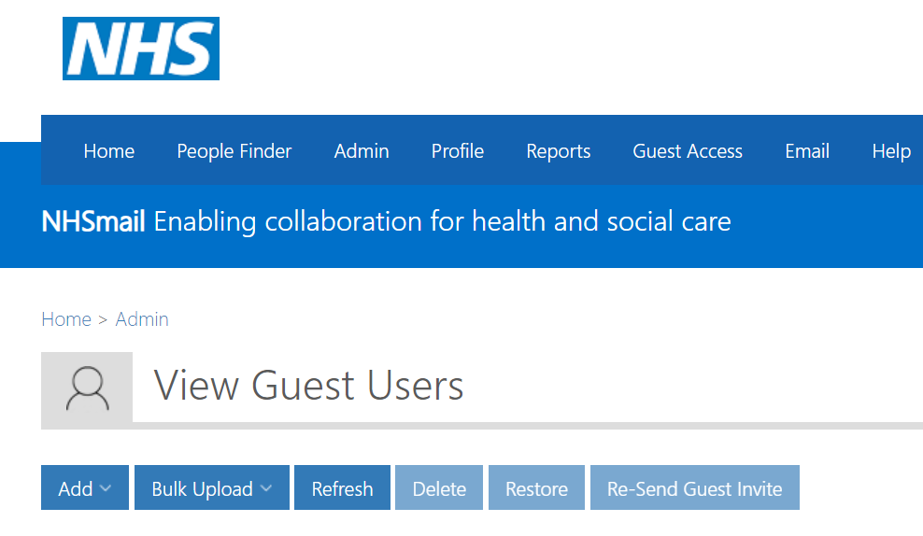

NHS GUEST ACCOUNTS ARE THE BANE OF MY LIFE

Slide 16
Burnout.

Slide 17

Where we are today

Slide 18
“Technology is nothing. What's important is that you have a faith in people, that they're basically good and smart, and if you give them tools, they'll do wonderful things with them”
Steve Jobs

Slide 19

Thank You
Nadia.Kuftinoff1@nhs.net
Bluesky: @nadiakuftinoff.bsky.social

